Slide 1

Examining Best Locations for a Pop-Up Food Pantry: A Clustering of Chicago Area Communities by Income and Population
Final Capstone Project Jan 2021
R.Peña

Slide 2
Introduction
Chicago is the 3rd largest city in the US and currently struggling with respect to food insecurity brough on by COVID lockdowns and wealth inequality
There are over 200 neighborhoods in Chicago broken down into 77 Chicago Community Areas
Because of this increased strain on food banks, it is more important than ever to make wise use of existing resources
This analysis is designed to address two research questions:
How are the 77 community areas of Chicago similar with respect to income and population and most popular venues (specifically grocery/restaurant)?
Where should food non-profit organizations and city agencies establish temporary food banks to serve the most needy people in the city?

Slide 3
Data Description
To answer these two questions, Chicago neighborhood data was gathered and clustered along two dimensions:
Median Household Income
Total Population Size
Chicago Community Data was downloaded from the Chicago Metropolitan Agency for Planning (CMAP)
Additional data related to the venue types was accessed by neighborhood was obtained via:
The Foursquare API
Google Maps Platform Geocoding API

Slide 4
Methodology
To analyze the CMAP data, a k-means cluster analysis was applied to the dataset
A total of 9 clusters were developed, led by the assumption that high, middle and low income groups cut across highly-, medium- and low-populated areas.
This would result in a 3 x 3 tiered stratification across population and income
To obtain grocer and restaurant venues in each area, GET requests were written and called
The results were then extracted to a pandas dataframe and exported
A frequency analysis was performed on these data

Slide 5
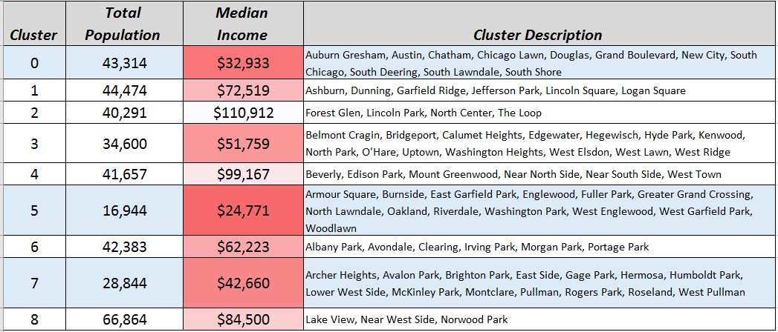
Results
The community areas were grouped into a total of 9 clusters
The lowest income clusters were the least populated
The most economically disadvantaged clusters account for almost half of Chicago communities (38/77 = 49%)

Slide 6
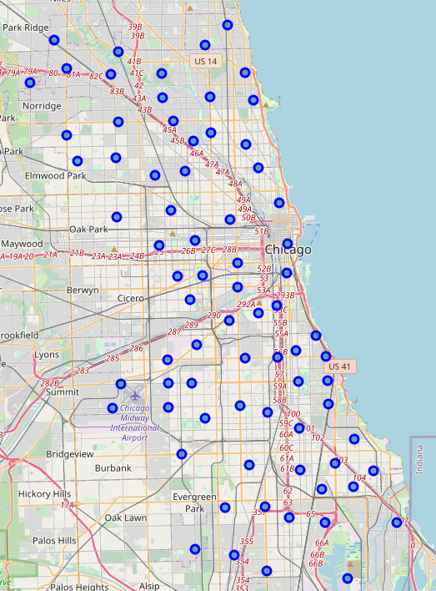
Results (cont’d)
The 77 community areas are represented in blue
A segmentation was run on these to group by income and population density

Slide 7
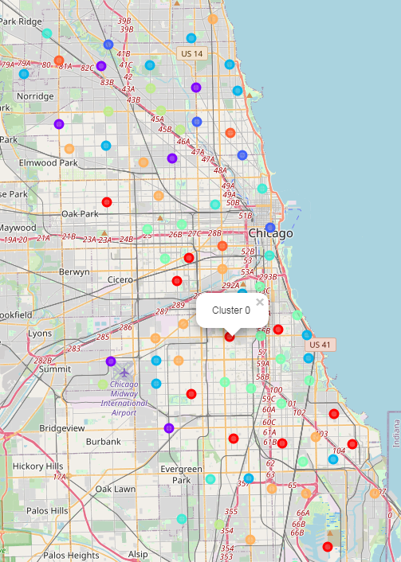
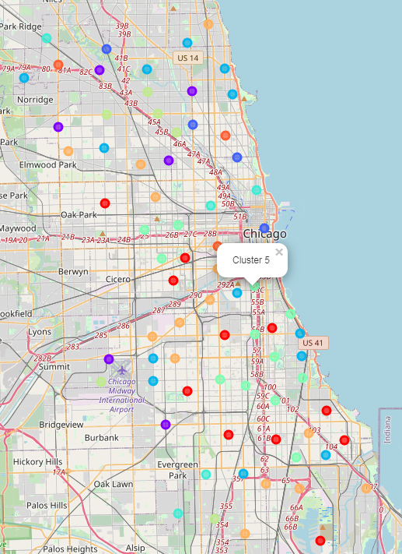
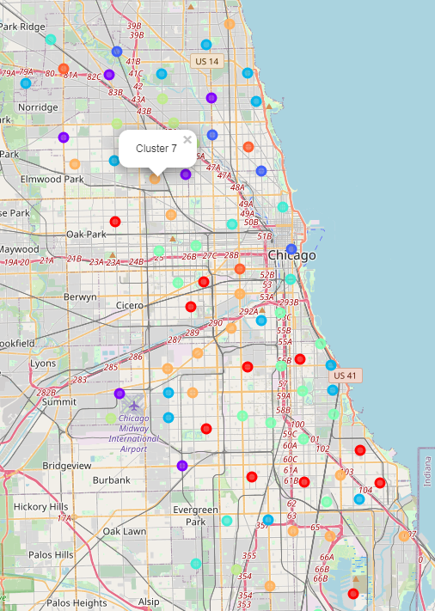
Results
The lowest income clusters are 0, 5 and 7 (red, green and orange)

Slide 8
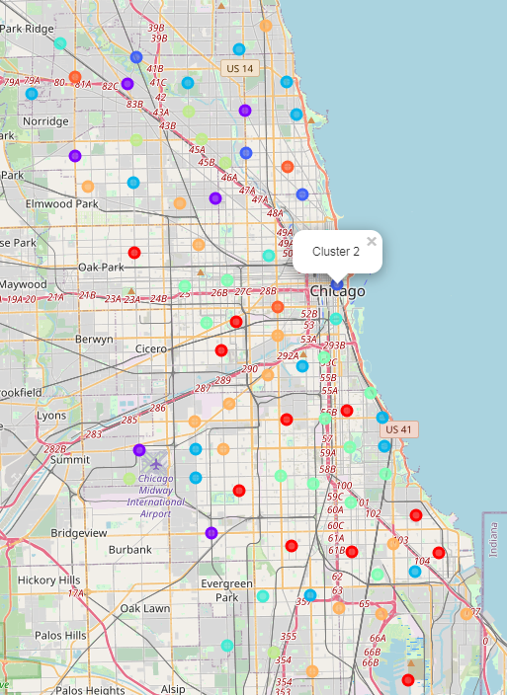
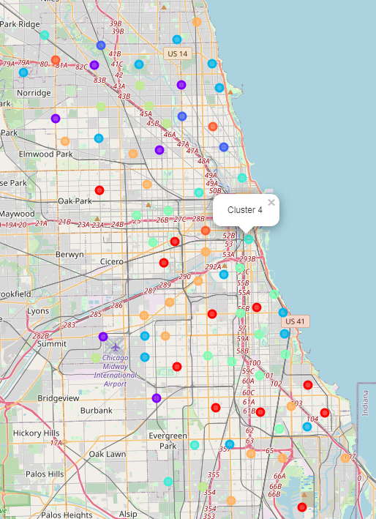
Results
The highest income clusters are 2 and 4.
They are marked by blue and teal color markers
Notably, they are close to the lakefront and other desirable, mid- to high- populated areas

Slide 9
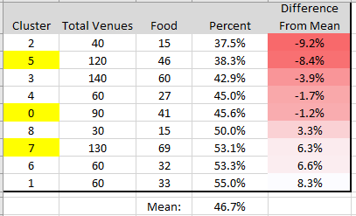
Results (cont’d)
A frequency analysis of the number of total Food Related Venues compared to Total Venues was done
The mean number of grocers, restaurants and other food venues was 46.7%
The lower income clusters varied in their frequency of food venues appearing in their top ten venues
Food venues included:
Grocery stores, supermarkets, farmers markets
Specific cuisine shops (e.g., “taco place”, “burger joint”, “pizza place”)
Ice cream parlors, donut shops and candy stores were excluded

Slide 10
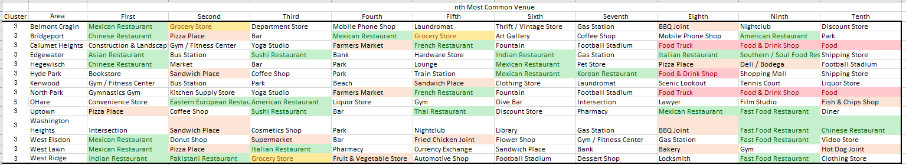
Results (cont’d)
The types of categories that surfaced from the Foursquare data was quite varied
Example for Cluster 3:

Slide 11
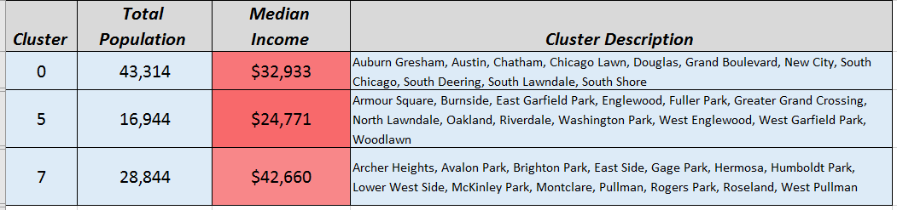
Discussion and Conclusion
It is our recommendation that the areas that would be best served by a temporary, or pop-up, food pantry are those associated with Clusters 0, 5 and 7
These clusters are marked by:
Lower income households
Low- to mid-sized population totals
Mixed availability of access to restaurants, grocers and food providers

Slide 12
Discussion and Conclusion (cont’d)
The two main take-aways from this research are:
Stakeholders wishing to focus building new or temporary food pantries should focus on median income rather than population size of the area.
In Chicago, lower income populations reside in more sparsely populated neighborhoods
Areas within clusters 0, 5 and 7 are the most ideal areas to target.
Stakeholders should make their decisions on opening new food pantries based on the income and population clustering and disregard the frequency of venue type, as the Foursquare data is quite mixed across neighborhoods
The highest income cluster in Chicago has the least amount of food/restaurant establishments
The presence of food/restaurant establishments in a given area may be a poor indicator of overall household need

Slide 13
Discussion and Conclusion (cont’d)
Lastly, when determining the optimal locations for a pop-up food pantry, volunteer organizations may need to weigh more practical considerations in their decision making, including:
Access to public transportation for the target groups
Availability of car parking for individuals traveling from other parts of the city
Flexibility and cooperation of local alderman to select and protect sites
Ease of arranging for street closures should sites be placed outdoors
Cost of erecting distribution facilities for outdoor venues

Slide 14
Additional Sources:

Slide 15
For comments/questions, please email: mail.reyna@gmail.com

